Slide 1
SIMULATION OF A SCHEDULER
Team Members
Kavya Sri
Neha Sulthana
Ramya
Mamatha
Varshitha

Slide 2
CONTENTS
Abstract
Introduction
UML Design
About Project
Future Scope
Conclusion

Slide 3
ABSTRACT
Scheduling is one of the most primary and essential part of any operating system. It prioritizes processes to efficiently execute the user requests and help in choosing the appropriate process for execution..

Slide 4
INTRODUCTION
Scheduling is a fundamental operating-system function. The processor is the most important resources.
Scheduling becomes very important in achieving the system design goals. Many algorithms have been designed to implement scheduling.
This work involves development of a simulator for scheduling.
This simulator can be used for measuring performance of different scheduling algorithms. It simulates First Come First Serve (FCFS) scheduling, Shortest Job First (SJF) scheduling, priority scheduling, and Round Robin (RR) scheduling.

Slide 5
OBJECTIVE
The main objective of our project is that it is a client server based model.
Client will be our command line interface and server is the one which is the main process which will get the input and store in different data structure.
Scheduler will run that process one by one depending on the selected algorithm.
User will give the list of process and it also act like simulating the scheduler.

Slide 6
SOFTWARE REQUIREMENTS
Cloud Machine
Linux

Slide 7
SOFTWARE RESOURCES
CPP Unit
Valgrind
System Programming

Slide 8
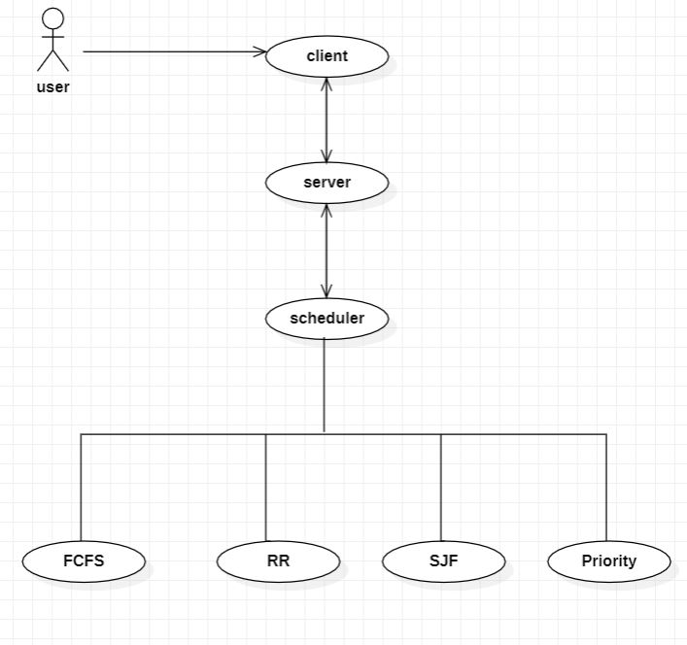
UML DIAGRAM 1.UseCase Diagram

Slide 9
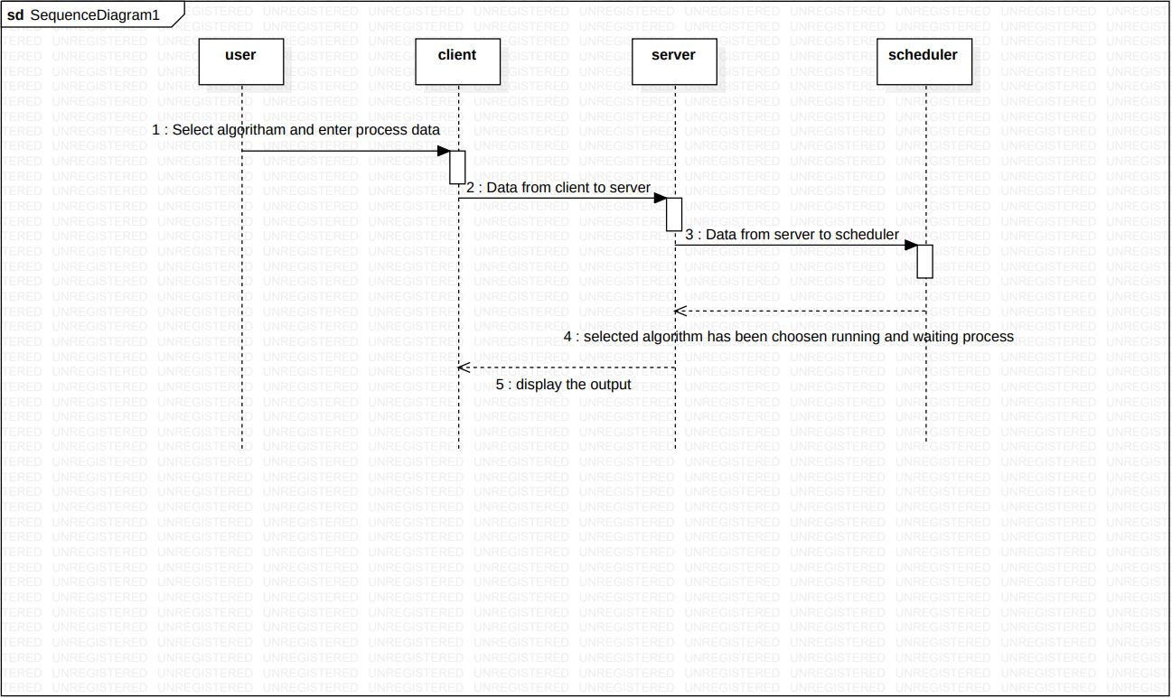
2.Sequence Diagram

Slide 10
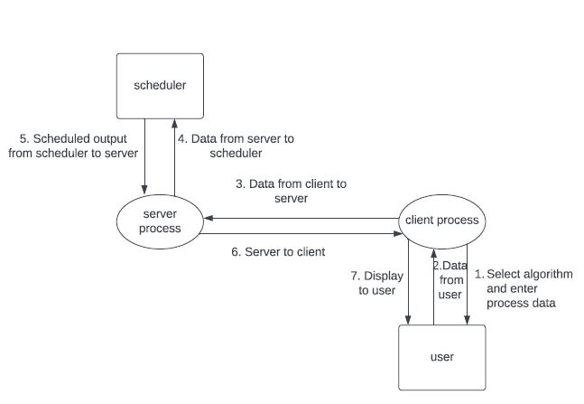
LEVEL DIAGRAM LEVEL 0

Slide 11
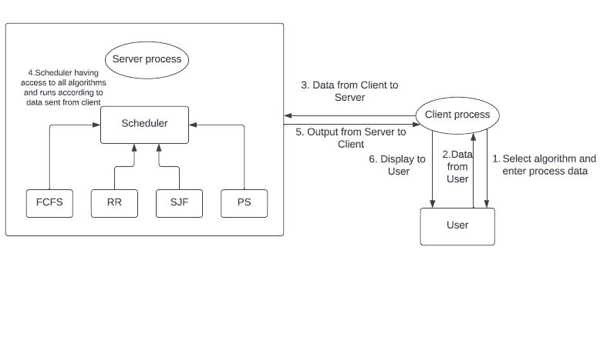
LEVEL 1

Slide 12
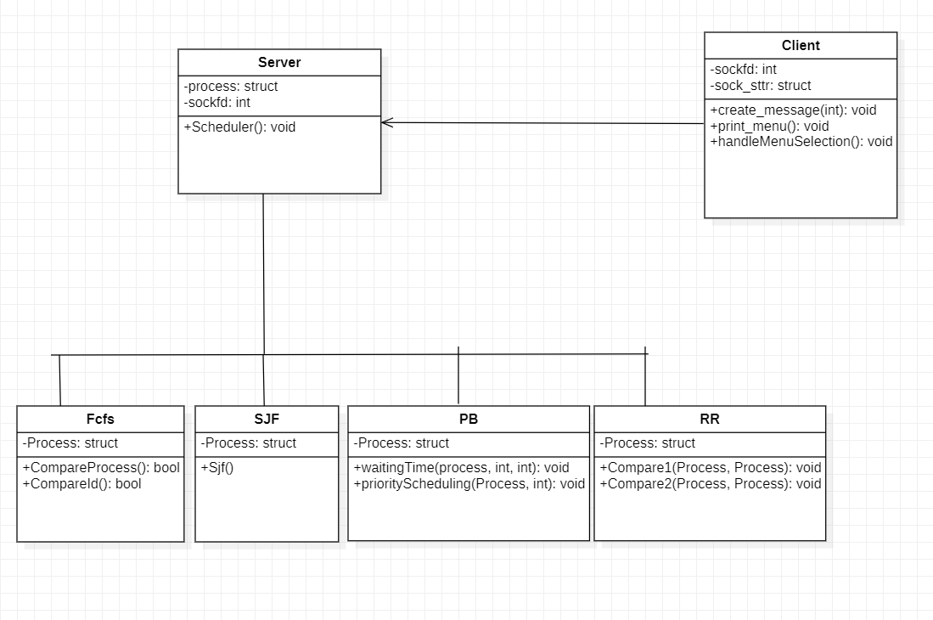
Class Diagram

Slide 13
ABOUT PROJECT
The application will display a main menu to select options such as algorithm.
The application will validate the menu options at each level. If any incorrect option or entry by the user should display an error.

Slide 14
For FCFS algorithm selection, the given process order is treated as the order of execution.
For SJF algorithm selection, the user should provide total execution time in seconds for each process along with process path.
For priority algorithm selection, the user should provide the priority for each process along with the process path.
For RR algorithm selection, the user should provide time quantum duration in seconds for each process along with process path.

Slide 15
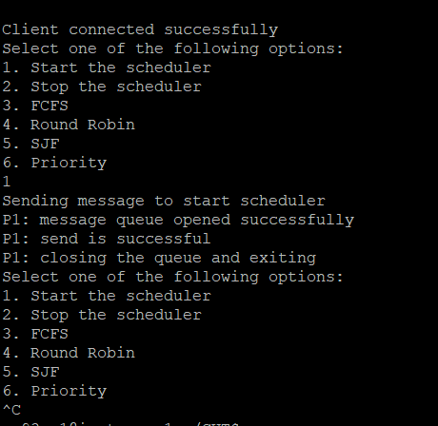
Menu Interface

Slide 16
CONCLUSION
We have implemented a project on simulation of a scheduler.
Simulator CPU Scheduling Algorithm was developed which contained a number of simulation modules. Four CPU scheduling.
Strategies were integrated with algorithm for obtaining real time performance results. Each module executes the selected algorithm and displays results.

Slide 17
FUTURE SCOPE
Serving multiple clients instead of only one client results in scheduling algorithm being busy as much as possible. The algorithm should make efficient use of the CPU.
when a process leaves the CPU idle next process for the CPU is to be selected and for this purpose many CPU scheduling algorithms are there which we can use.

Slide 18
THANK YOU

